Slide 1

COVID-19 Socioeconomic Analysis 17 OCT 2020
Connor Berek
Alex Fernandez
Justin Forkert
Mike Grad
Xi Zhang

Slide 2

Project Goals
Describe
Relationship between Covid-19 infection rates and mortality rates with income level
Describe
Relationship between Covid-19 infection rates and mortality rates with latitude in the US
Describe
Relationship between Covid-19 infection rates and mortality rates with population

Slide 3

Methodology for Analysis
Sourcing
Cleansing
Coding

Slide 4

Methodology: Data Sourcing
Source: CDC Data Sets
Covid-19 infection and mortality rates broken down by state within the United Stateshttps://data.cdc.gov/Case-Surveillance/United-States-COVID-19-Cases-and-Deaths-by-State-o/9mfq-cb36

Slide 5
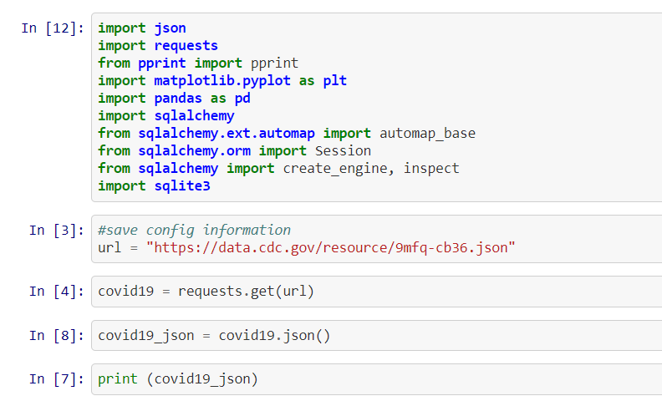
Methodology: Data Sourcing
Get Dynamic Covid 19 data through API

Slide 6
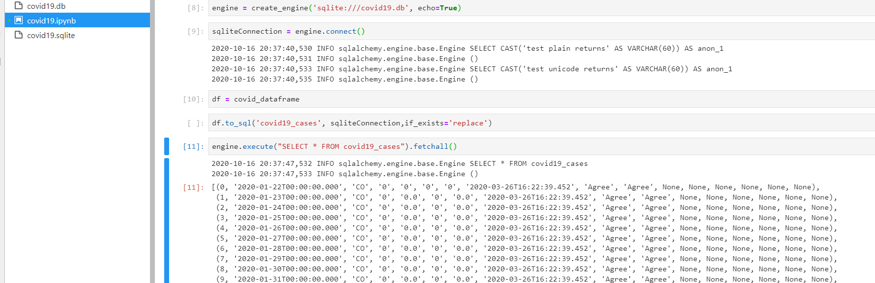
Methodology: Data Sourcing
Create data frame
Save as sqlite file

Slide 7
Methodology: Data Sourcing
Source: Google searches
Latitude and Longitude by state
Created a csv
Source: Bureau of Economic Analysis (BEA)
https://apps.bea.gov/iTable/iTable.cfm?reqid=70&step=1&isuri=1&acrdn=1#reqid=70&step=1&isuri=1&acrdn=1
Median income and population
Downloaded as a csv

Slide 8
Methodology: Data Cleansing
Covid-19 data, median income, and median population data joined in pgAdmin on key field states
The following fields were inspected for completeness and consistency
insert

Slide 9
Methodology: Coding HTML & CSS
HTML structured using Bootstrap to create dashboard layout
INPUTS:
Leaflet
D3
JS

Slide 10
Methodology: Coding JavaScript Outputs
Maps
Infection Rates across US or selected state with Popup (US only)
Mortality Rates across US or selected state with Popup (US only)
Plots
Infection Rate by Latitude for US or state
Mortality Rate by Latitude for US or state
Infection Rate by Median Income
Mortality Rate by Median Income

Slide 11
Methodology: Coding JavaScript Outputs cont’d
Covid-19 Tracker
Use Search Bar or Click on Map
Tooltip with Statistics
Infection Rate
Mortality Rate
Median Income
Population
Prepopulate with current US data

Slide 12
Methodology: Coding JavaScript Functionality
Selectors
Map: Infection Rates or Mortality Rates
Charts: Plots by Latitude
Datasets: Covid-19 data or income/population data
Form textbox search by state
Color coding by level of infections

Slide 13

Challenges
The team experienced the following challenges during the project
Laptop owned by Mike Grad could not be used between Friday and Tuesday due to battery problems

Slide 14

Conclusions
Covid-19 vs. Latitude
No relationship for infection rate and mortality
Covid-19 vs. Median Income
No relationship for infection rate and mortality
Covid-19 vs. Population
Positive relationship between both infection rate and mortality rate and the population size

Slide 15

Questions

